Slide 1
Architectural Design
Management of Software Systems

Slide 2
Software architecture
Software architecture of a program or computing system is the structure or the structures of the system, which comprise the software components, the externally visible properties of those components, and the relationship among them

Slide 3
Why architecture ?
Architecture is not the operational software. Rather it is a representation that enables a software engineer to
Consider architectural alternatives at a stage when making design changes is still relatively easy, and
Analyze the effectiveness of the design in meeting its desired requirements
Reduce the risks associated with construction of the software

Slide 4
Data design
Architectural level -> Database design
Component level -> Data structure design
Data mining
Data warehousing

Slide 5
Architectural styles
Each style describes a system category that encompasses
A set of components (eg. A data base, computational modules) that perform a function required by a system
A set of connectors that enable communication, coordination, and cooperation among the components
Constraints that define how components can be integrated to form the system and
Semantic models that enable a designer to understand the overall properties of a system

Slide 6
Specific styles
Data centered architecture
Data flow architecture
Call and return architecture
Object oriented architecture
Layered architecture

Slide 7
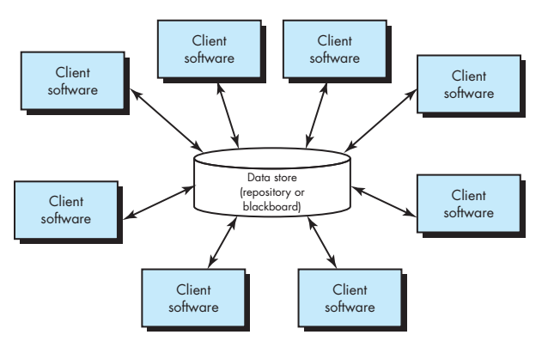
Data centered architecture

Slide 8
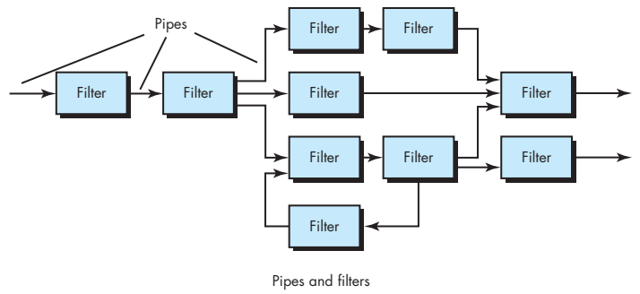
Data flow architecture

Slide 9
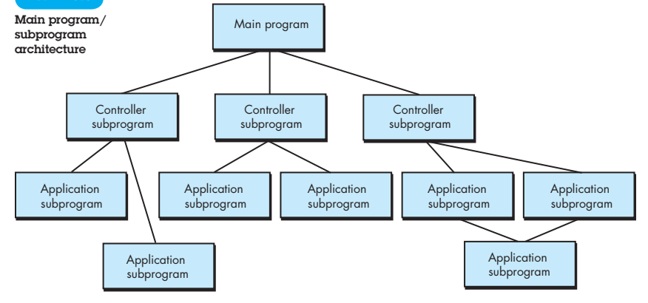
Call and return architecture

Slide 10
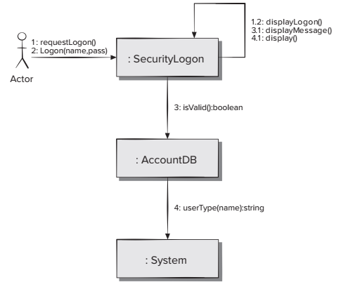
Object oriented architecture

Slide 11
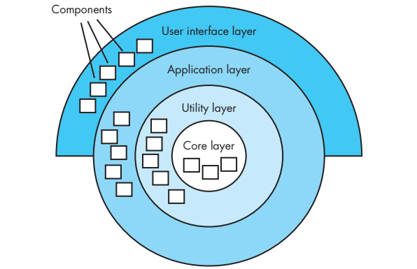
Layered architecture

Slide 12
Architectural patterns
Concurrency
Operating system process management
Task scheduler
Persistence
Data base management systems
Application level persistence
Distribution
broker

Slide 13
Architectural Design
Architectural context diagrams
Model how software interacts with external entities
Archetypes
Are classes or patterns that represent an abstraction critical to the system
Architectural components
Are derived from the application domain, the infrastructure, and the interface

Slide 14
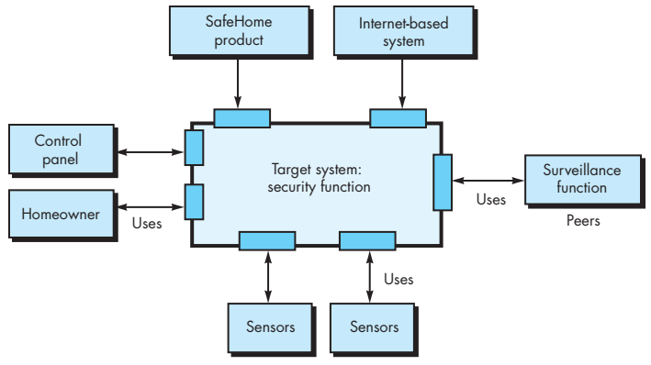
Architectural Context diagram for the SafeHome security function

Slide 15
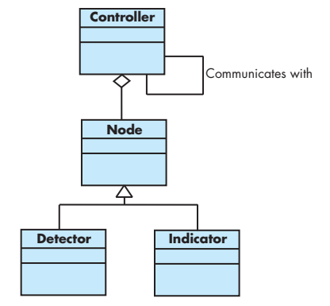
SafeHome archetype UML relationships for SafeHome security function archetypes

Slide 16
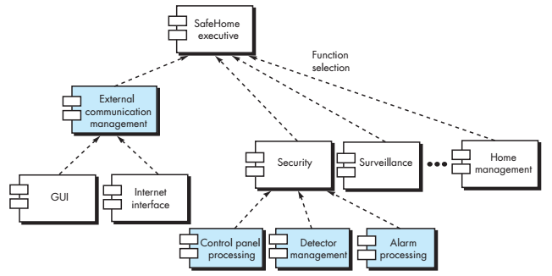
Component structure

Slide 17
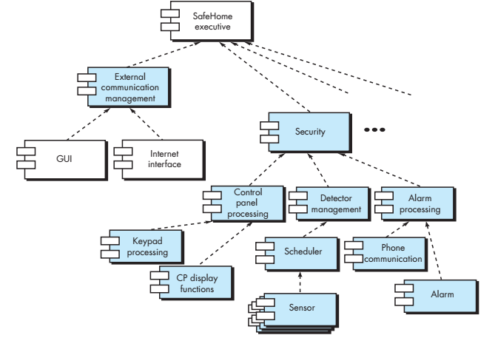
Component elaboration

Slide 18


